Slide 1


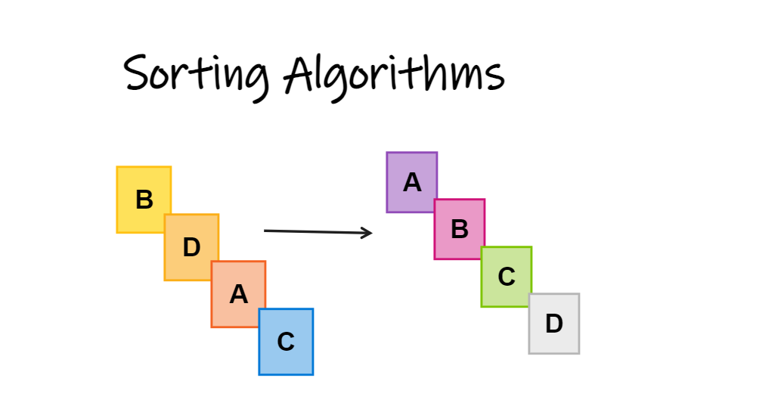
SAVEETHA SCHOOL OF ENGINEERING
SAVEETHA INSTITUTE OF MEDICAL AND TECHNICAL SCIENCES
CSA0697 DESIGN AND ANALYSIS OF ALGORITHM FOR LOWER BOUND THEORY
TOPIC:Analyzing the time complexity and performance of different sorting algorithms
FACULTY NAME: Dr.Gnana Soundari
By,
NAME :THARUN.R
REG.NO 192210662

Slide 2
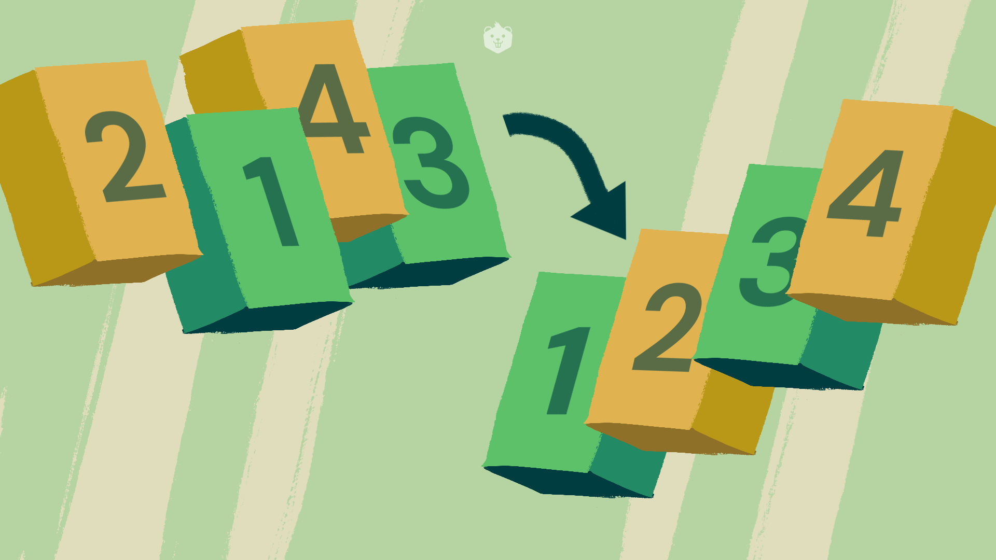
INTRODUCTION:
1.Sorting is a fundamental operation in computer science used to arrange elements in a specified order. It is essential for data organization, search optimization, and improving algorithm efficiency.
2.Different sorting algorithms have varying time complexities and performance characteristics.
Understanding these differences helps in selecting the most appropriate algorithm for a given problem.
3.Time complexity measures the amount of time an algorithm takes to complete as a function of the input size.

Slide 3

SORTING TECHNIQUES AND TIME COMPLEXITY:
1.A sorting algorithm is a method used to reorder elements in a list or array according to a specific order (e.g., ascending or descending). The goal is to organize data to improve readability, efficiency, and performance in subsequent operations.
2. Time Complexity:
Definition: Time complexity measures the amount of time an algorithm takes to complete relative to the size of the input data.

Slide 4
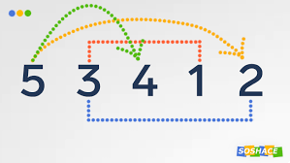
LINEAR SORT:
1.Linear Sort algorithms refer to sorting techniques that achieve linear time complexity, typically denoted as O(n), or near-linear time complexity, such as O(n + k),
Time Complexity:
Best Case: O(n + k)
Average Case: O(n + k)
Worst Case: O(n + k)
Where:
n = number of elements in the input array
k = range of the input values (difference between the maximum and minimum values)

Slide 5
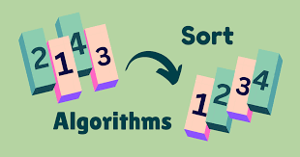
BUBBLE SORT:
Bubble Sort is a simple and intuitive algorithm, but its O(n^2) average and worst-case time complexity make it inefficient for large datasets. Its simplicity and stability can be advantageous in specific scenarios, but for most practical applications, more efficient sorting algorithms are preferred.
Best Case: O(n)
Average Case: O(n^2)
Worst Case: O(n^2)

Slide 6
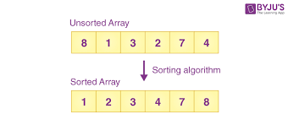
QUICK SORT:
1.Quick Sort is a divide-and-conquer algorithm that works by selecting a "pivot" element from the array and partitioning the other elements into two sub-arrays according to whether they are less than or greater than the pivot. The sub-arrays are then sorted recursively.
Space Complexity: O(log n) on average
Best Case: O(n log n)
Average Case: O(n log n)
Worst Case: O(n^2)

Slide 7
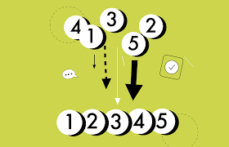
SELECTION SORT:
Selection Sort is a straightforward comparison-based sorting algorithm. It repeatedly selects the smallest (or largest) element from the unsorted portion of the array and moves it to the end of the sorted portion.
Best Case: O(n^2)
Even if the array is already sorted, Selection Sort still performs the same number of comparisons.
Average Case: O(n^2)
On average, it performs (n-1) + (n-2) + ... + 1 comparisons, which sums to O(n^2).
Worst Case: O(n^2)
The performance remains the same regardless of the initial arrangement of the array.

Slide 8
CONCLUSION:
1.Sorting algorithms are fundamental to many applications, and choosing the right one is crucial for optimizing performance.
Future Exploration:
1.Considering exploring more advanced sorting algorithms and optimization techniques to handle larger datasets and specific requirements effectively.
OVERALL:
We explored different sorting algorithms including Bubble Sort and Selection Sort, focusing on their time complexities and performance characteristics.

Slide 9


